Slide 1



System Memory QoS Challenge
Oliver Yang
Jun 5，2018
More Than Just Cloud

Slide 2
1. Background
More Than Just Cloud

Slide 3
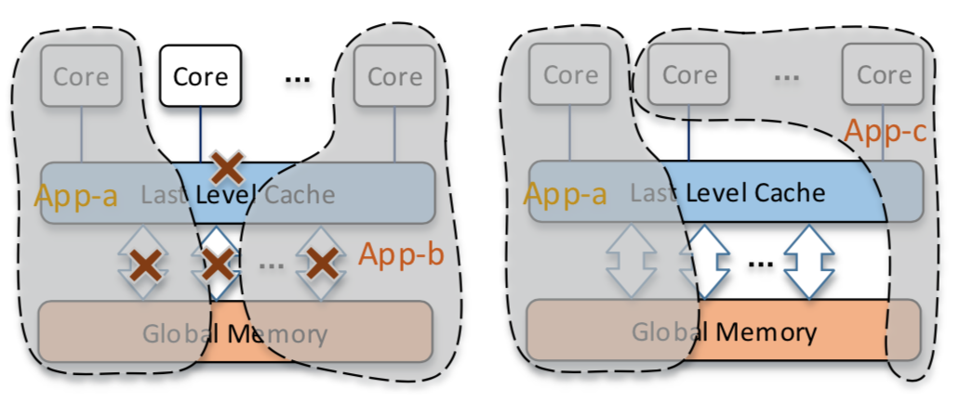
Service Consolidation & Co-location Practice
Goal: Increase data center hardware utilization
Idea: Consolidate multiple workloads with acceptable QoS loss
Borg/Kubernetes, VMware DRS etc.
Challenge: Avoid contentions among multiple workloads
Workload characterizations
Resource model: Compute bound + IO bound
Time sharing: Peak time + Off-peak time
OS resource control & isolation features
More Than Just Cloud

Slide 4
More Challenges In Webscale Data Center
Scale-out optimization at large scale
Resource QoS classifications & scheduling
Workload placements(Bin-packing) algorithm
Dynamic distributed load balance & scheduling
Constantly varying load challenges from cloud native applications
The synthetic test environment has poor coverage
Many issues can be only found on real online environment
Using statistics to determine the impact of a change
Performance or resource characters could be totally changed after a time period
Paper: Performance Analysis of Cloud Applications – NSDI 2018
More Than Just Cloud

Slide 5
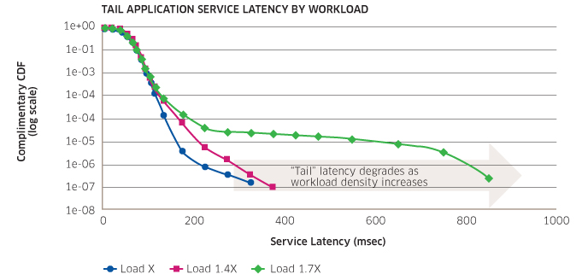
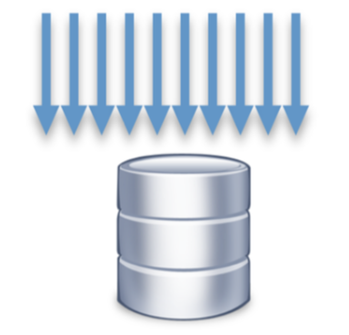
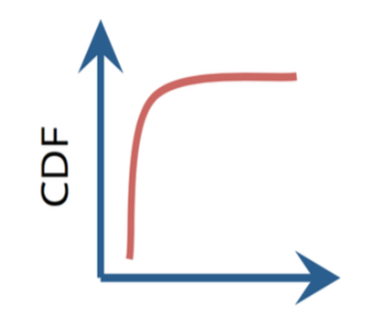

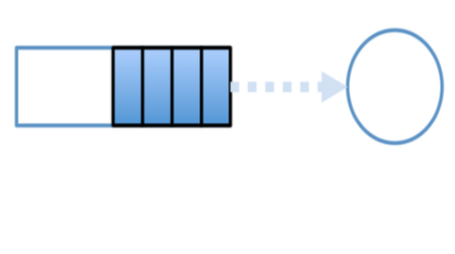
Co-location Jitters & Causes
System performance jitters RCA (Root Cause Analysis) can be very challenge…
Burst randomly
In a very short period
Reported/found very late
Always postmortem analysis
Without enough debug data
Tradeoff between utilization and QoS
Avoid jitters by resource isolations
HW Resource Contentions
Skewed Access Pattern
Queuing Delays
Background Activities
More Than Just Cloud

Slide 6
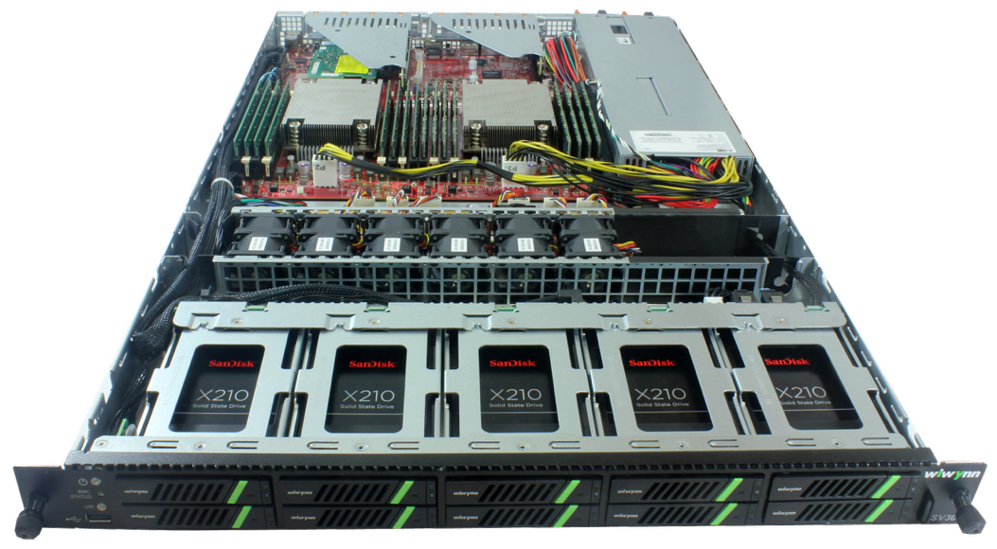
OS Resource Control & Isolation
System wide optimizations
Hardware & Software cooperate together
Full stack optimizations
3 major aspects
Performance isolation
Fault isolation
Utilization Increase
CPU: CAT, Cgroup, Noise Clean, Scheduler Optimization
Memory: MBM, MBA, Cgroup, Idle page tracking
Network: TC, HTB, Lockless Qdisc
IO: Write back Cgroup, Low/Upper limit，
Weight, File Level-Based IO Throttle
More Than Just Cloud

Slide 7
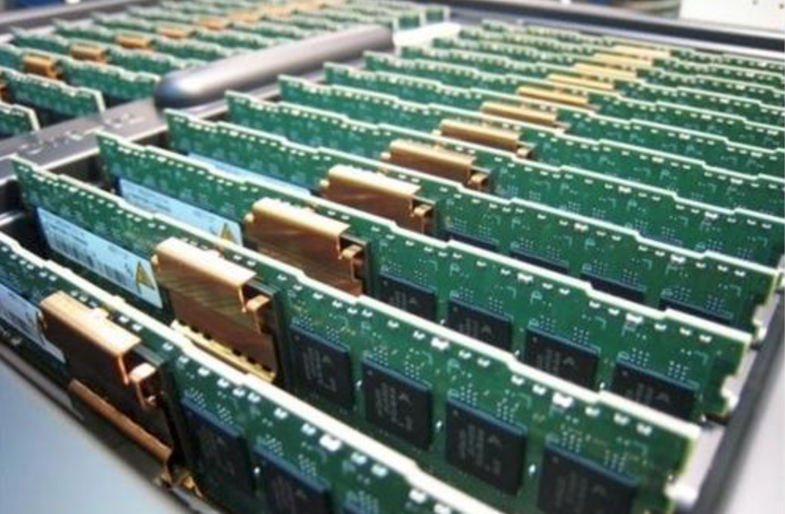
Why Memory Matters
DRAM cost is close to CPU recently
Memory is incompressible resource
Challenges
Capacity planning is difficult: OOM, Various Jitters, Bad utilization
Memory overcommit has more risks: OOM, Jitter
The bottlenecks of compute density
Big data, Tensorflow…
4 NUMA node servers
Opportunities
New NVM hardware
AEP, Optane, NVME SSD
AI technologies
More Than Just Cloud

Slide 8
Memory QoS Requirements
Performance Isolation
Memory access performance shouldn’t be interfered by other containers/VMs.
Fault Isolation
Memory faults should be self-contained and shouldn’t have global QoS impacts
Utilization Increase
Memory utilization should be increased without QoS regressions
Fault Isolation
Software fault
Hardware fault
Utilization Increase
Capacity Planning
Memory Overcommit
Perf Isolation
Throughput
Latency
More Than Just Cloud

Slide 9
2. Performance Isolation
More Than Just Cloud

Slide 10
Performance Isolation - Direct Memory Access
Problem: Hardware resource contention
Analysis: CPU PMU counters
Solution: Hardware & software work together
Intel RDT (CAT/MBA)
Software memory access pattern optimization
TLB/Cache/Memory(NUMA)
Memory Performance
Direct Access
TLB
L1
L2
L1/L2/LLC
Local
Remote
DRAM
Local
Remote
Device MMIO
Paging on demand
Fast Path
Slow Path
Local
Remote
More Than Just Cloud

Slide 11
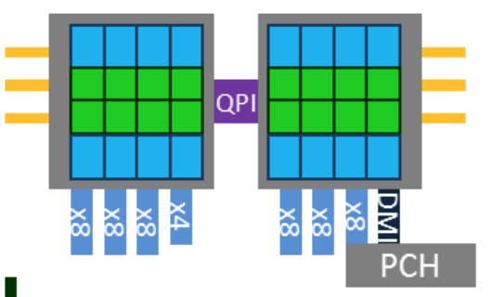
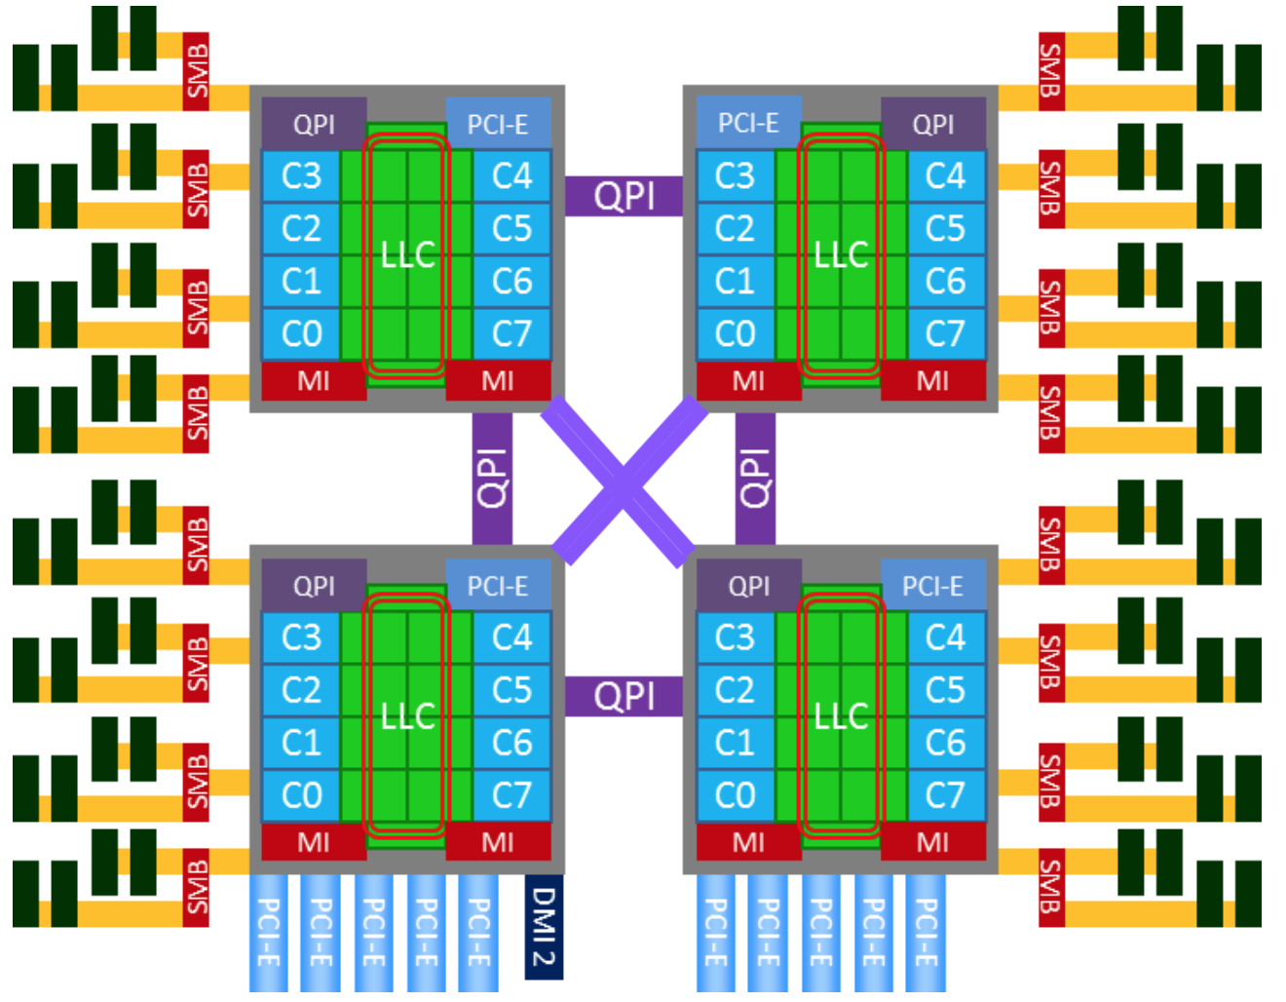
Perf Metrics For Direct Memory Access
CPI/IPC/MIPS
Perf stat - IPC
Pmu-tools – toplev, ocperf
TLB Hit/Miss/Flush
Perf stat – tlb miss, flush events
Cache Hit/Miss
Perf mem – access ratio
Memory Latency/BPS/IOPS
Numatop - Local/Rmote
Perf c2c – access ratio, latency
Perf c2c – access ratio, latency
Perf stat – cache miss events
Resctrl - CQM and MBM
perf mem – access ratio
Notes: Some metrics have performance overheads
More Than Just Cloud

Slide 12
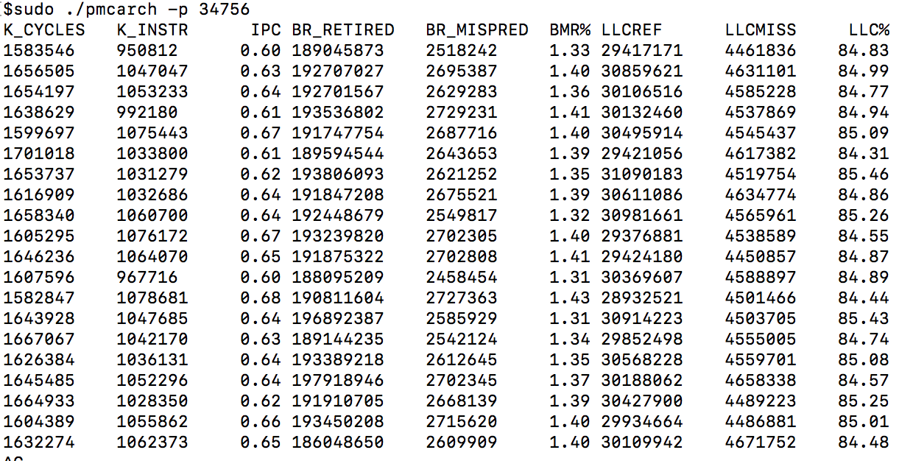
PMU Example 1 - IPC/Branch Miss/Cache Hit Profiling
PMU counters analysis based on perf stat
https://github.com/brendangregg/pmc-cloud-tools
More Than Just Cloud

Slide 13
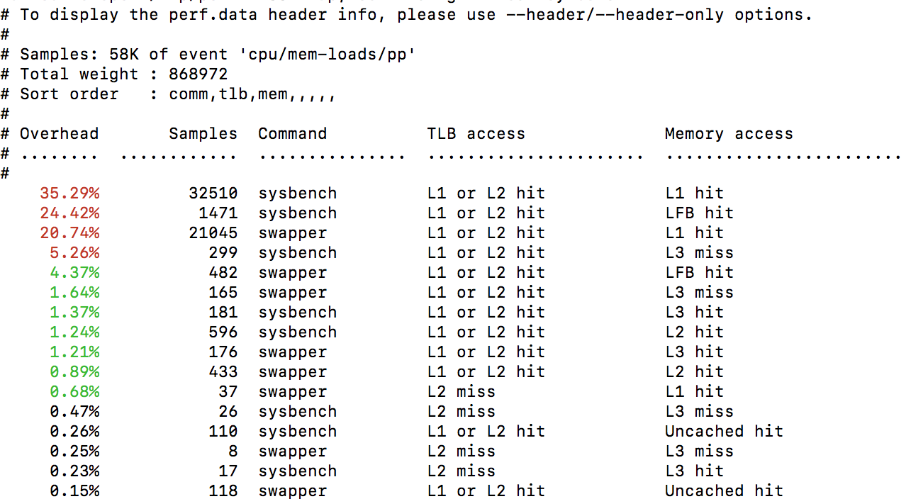
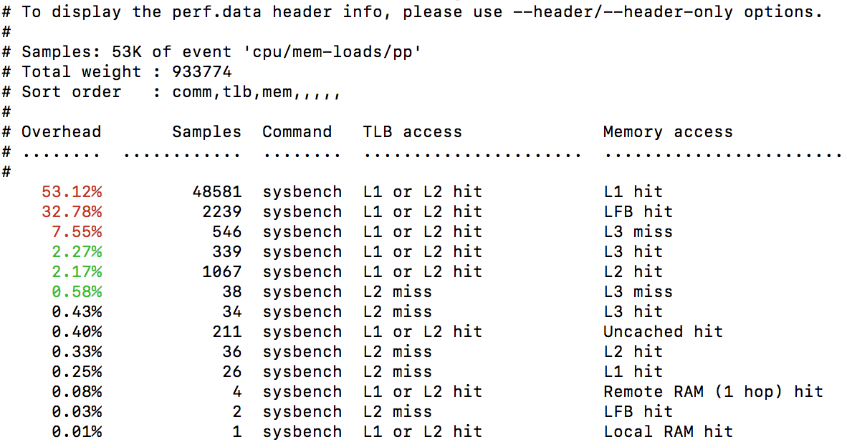
PMU Example 2 - Direct Memory Access Sampling
Using perf mem sampling
System wides & per-task
More Than Just Cloud

Slide 14
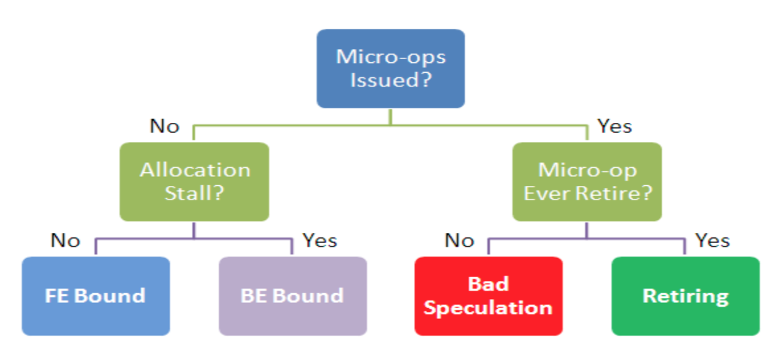
Detecting Noisy Neighbors - CPI/IPC
CPI - Cycle Per Instruction
IPC = 1 / CPI
Paper - CPI2: CPU performance isolation for shared compute clusters, Eurosys 2013
Intel Top-down Microarchitecture Analysis Method
PMU tools: https://github.com/andikleen/pmu-tools/wiki/toplev-manual
More Than Just Cloud

Slide 15
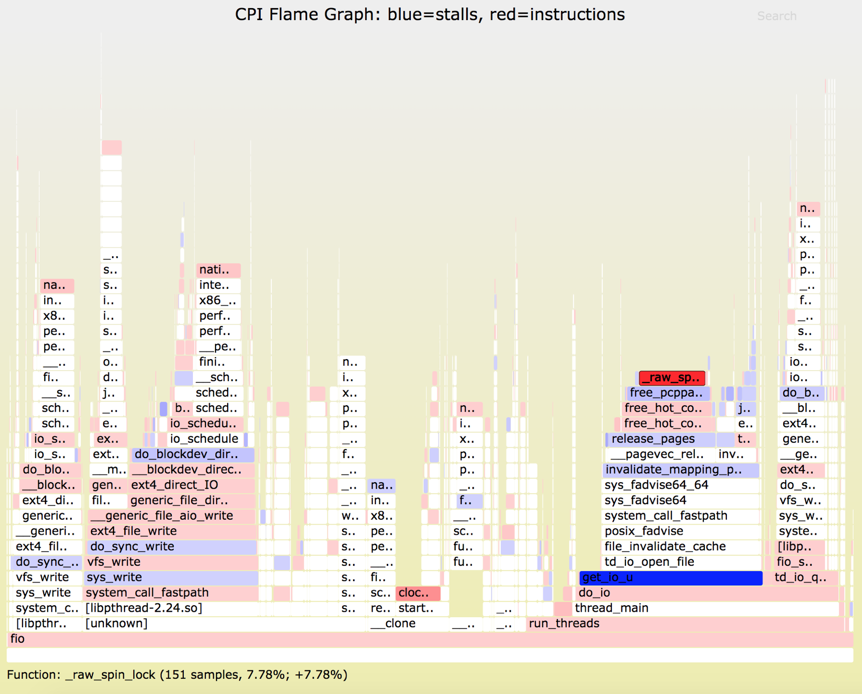
Detecting Noisy Neighbors - CPI Flame Graph
More Than Just Cloud

Slide 16
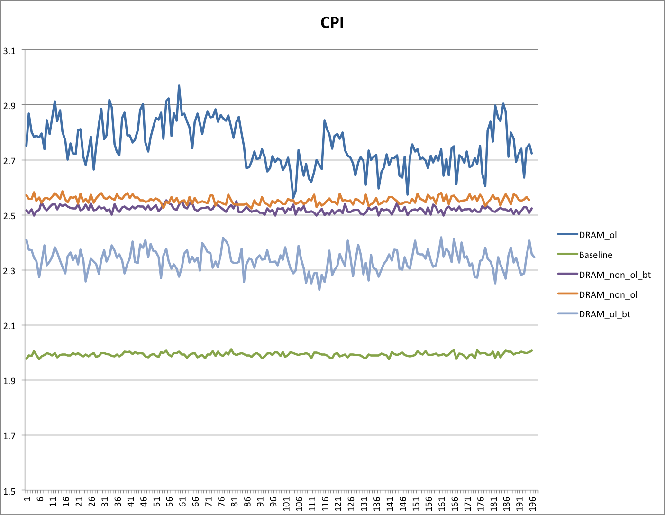
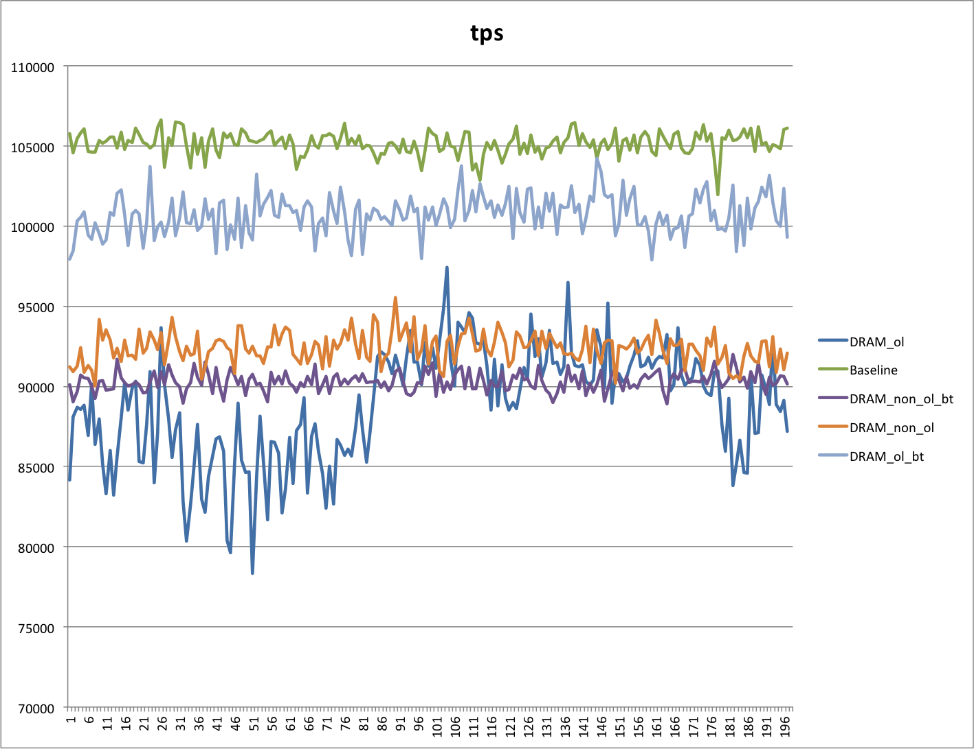
Case Study 1 - Contention Detection By CPI
Under sysbench & memory interference testing, MySQL TPS showed strong correlation with CPI
Notes: While MySQL TPS got dropped, the CPI was increased significantly
More Than Just Cloud

Slide 17
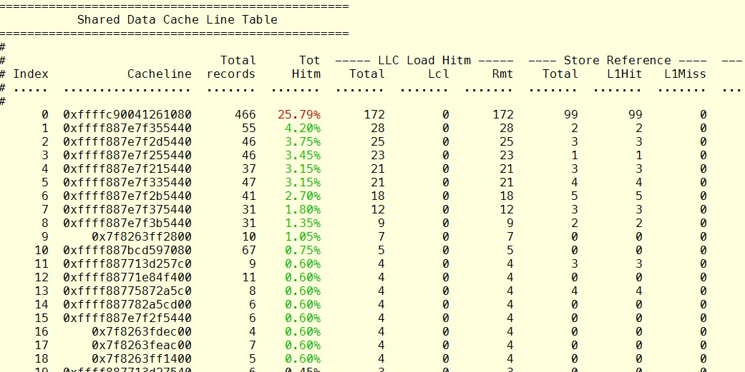
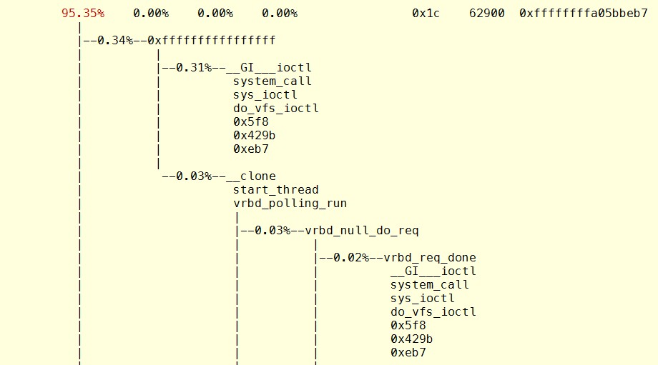
Case Study 2 - Fix Skew Memory Access Pattern
Cache false sharing debug
Using perf c2c
Focus on HITM
HITM - Hit In The Modified
Perf Boost 17.96%
More Than Just Cloud

Slide 18
Performance Isolation - On Demand Paging
Problem: Overheads from kernel paging mechanism
Analysis: Kernel counters and dynamic tracing
Solutions: Avoid running into slow path
Warm up and lock the pages
Increase min_free_kbytes vs. memory utilization
Google patch: per-memcg kswapd (incomplete & need more enhancements)
Paging on demand
Fast Path
Buddy
Slow Path
Compact
Direct
Background
Reclaim
Direct
Loop & Yield
Sleep
Background
THP
Zero out
COW
Split
Collapse
Lock contention
Dirty
Congestion
More Than Just Cloud

Slide 19
Memory Performance Isolation Challenges
Constantly varying load breaks static configurations
Offline capacity planning is not accurate
Static RDT (CAT/MBA) configurations can be broken
Static cgroup upper limit, low limit, reclaim watermark can be broken
Too many slow path corner cases under low free memory conditions
Memcg direct reclaim jitters under heavy buffer IO
Memory fragmentation and compaction jitters for long uptime system
THP (Transparent Huge Page) jitters under latency sensitive use cases
Online diagnosis, many jitters can only be found on real environment
Couldn’t be reproduced in the local synthetic test environment
Need continuous QoS data collecting and monitoring
Need online full stack tracing
Lack of cluster range QoS data statistics
Counter based metrics is not meaningful, and couldn’t be used for cluster statistic
Fine granularity statistics, for example, cgroup, task levels
More Than Just Cloud

Slide 20
Possible Solutions
Dynamic resource allocator for constantly varying load
Real time resource conflicts detection
Dynamic resource allocation for resilience handling
Avoid long-tail performance issue under low free memory conditions
Smarter capacity planning, not only offline, but also online
Smarter resource resource overcommit algorithm
Online & offline data collecting, diagnosis and prediction
QoS data analysis in cluster range
Jitter data collecting and diagnosis
Semi-real time analysis and prediction
More Than Just Cloud

Slide 21
Cluster QoS Data Normalization
Counter based metrics are not good for latency analysis
TLB miss, Cache miss, Page fault, Alloc stall, Compact stall
Use time based metrics for cluster data normalization
memdelay
Translated delays from counters into a pressure percentage of lost wall time
PSI - next version of memdelay
Expand the ideas to cover pressure stall information for CPU, memory, and IO
memdelay by Johannes Weiner
Slow Path time
Monitor interval (Wall Time)
More Than Just Cloud

Slide 22
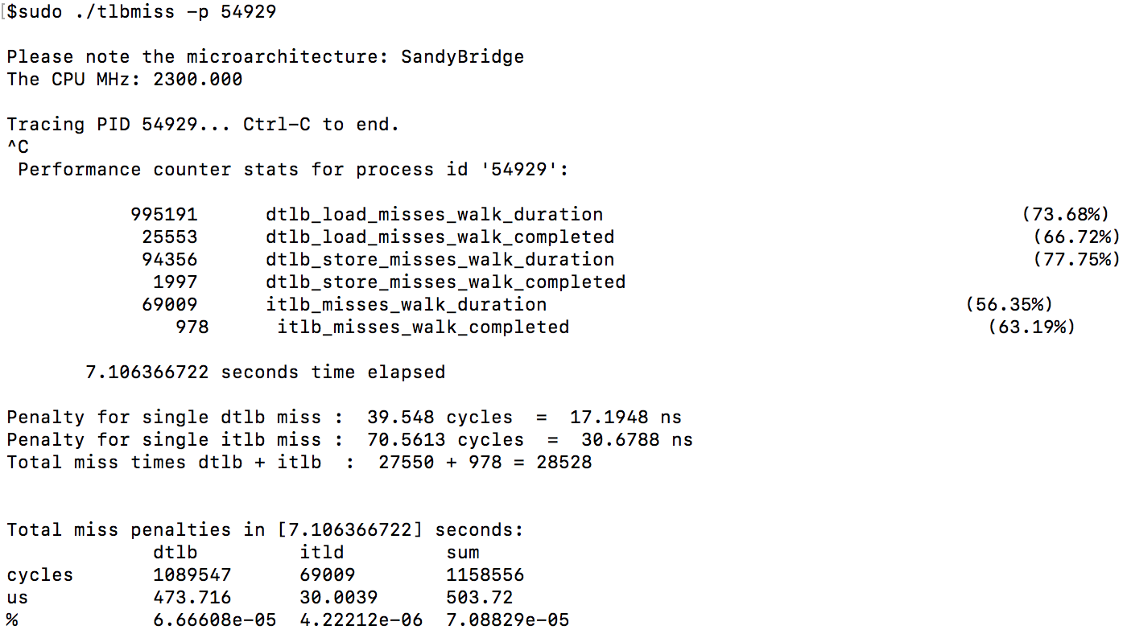
Example 1: TLB Miss Data Normalization
Time based TLB miss analysis
7% TLB miss time in past 7 seconds
More Than Just Cloud

Slide 23
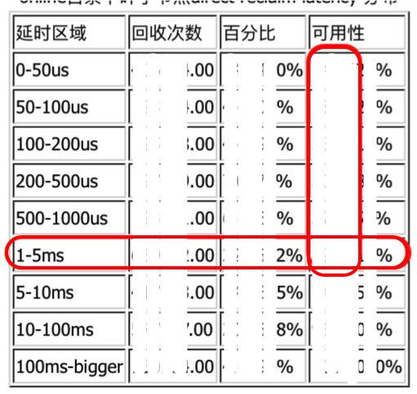
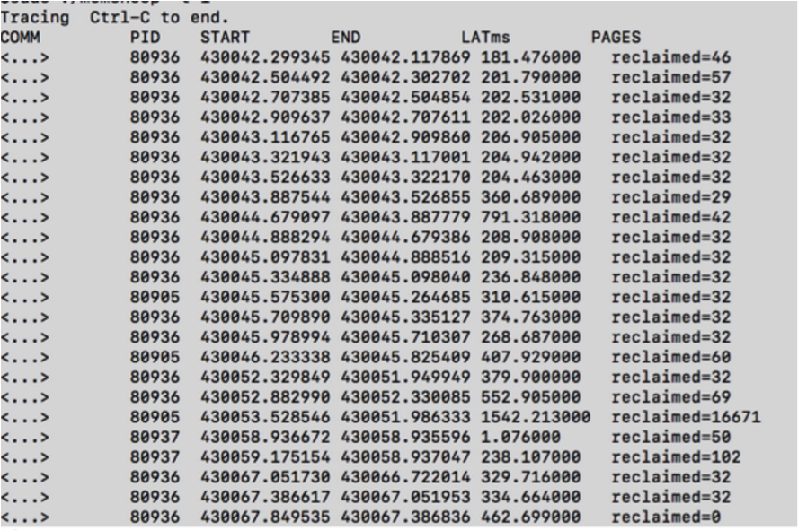
Example 2: Direct Reclaim Data Normalization
Direct reclaim
The allocstall counter in /proc/vmstat
Direct reclaim tracepoints
vmscan:mm_vmscan_direct_reclaim_begin vmscan:mm_vmscan_direct_reclaim_end
Direct reclaim latency histogram for a cluster
Latency range
Cumulative statistical data
More Than Just Cloud

Slide 24
3. Fault Isolation
More Than Just Cloud

Slide 25
Memory Faults & QoS Impacts
Software Fault
OOM Handling
Split-lock usage
Segfault from application
Hardware Fault
CE - Correctable Error
UE - Uncorrectable Error
QoS impacts
OS jitters caused by errors handling
Memory access latency
More Than Just Cloud

Slide 26
Fault Isolation Challenges
The significant interferences from faulty Cgroup
Fault handling code
Contention from global locks
Priority Inversion
TLB flush interrupts
IO pressure caused by core dump
Split-lock usage from buggy application
Error interrupts triggered by hardware errors
CMCI, NMI, SMI interrupts
OOM kill is NOT reliable, and has long latency
Resource starving under cgroup OOM handling
Lack of cluster online/offline faults statistics
Difficult to predict memory faults
More Than Just Cloud

Slide 27
Fault Handling Improvements
Cgroup OOM improvements
Predictable OOM kill: OOM reaper
Reduced overheads: OOM kill fixes
Efficient OOM kill: cgroup aware OOM kill
Fill online/offline memory faults analysis gaps
OOM counters: host and cgroup
Split-locks monitoring
Hardware faults monitoring
Interrupts monitoring
Memory faults VS. memory utilization, analysis together
More Than Just Cloud

Slide 28
OOM Interferences - A Design Issue
A memcg design problem
Memory pages are fully shared among Cgroups
Global locking and data structure couldn’t be avoided
Always could have jitters problems while cgroup OOM handling
Solutions
Using RunV for better fault isolation.
For RunC usage, the best way is to avoid OOM
Accurate memory working set estimation
A better memory starving prediction algorithm for memory overcommit
More Than Just Cloud

Slide 29
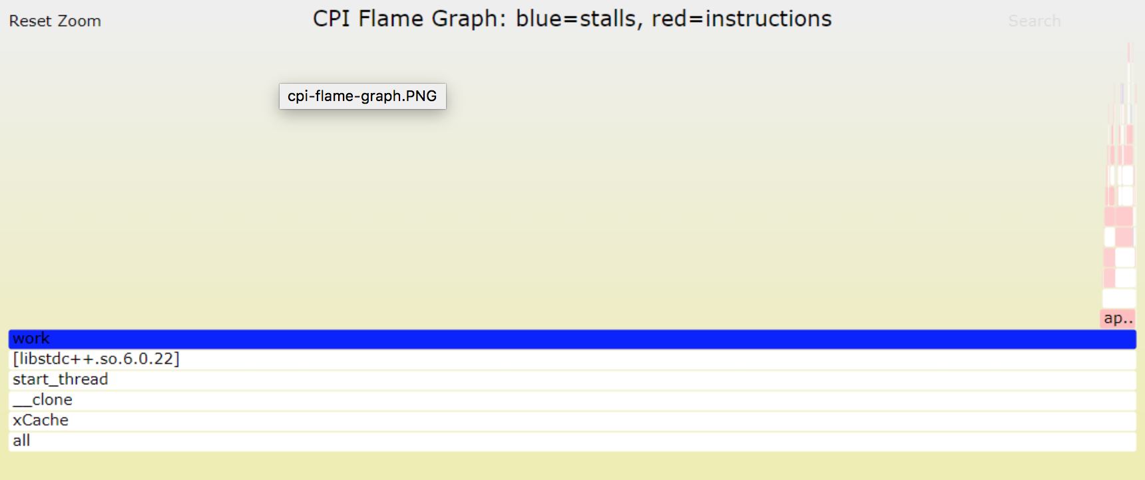
Split Lock Isolation - HW & SW solution
Software bugs
Atomic operation cross two cache lines
Overall system performance got impacts by faulty application
Solutions
Fix software bugs
Detecting split-locks and control split locks
#AC exception for new Intel processors
PMU data analysis
Fault isolation
Some error handlings in #AC handlers
Other ways…
More Than Just Cloud

Slide 30
4. Utilization Increase
More Than Just Cloud

Slide 31
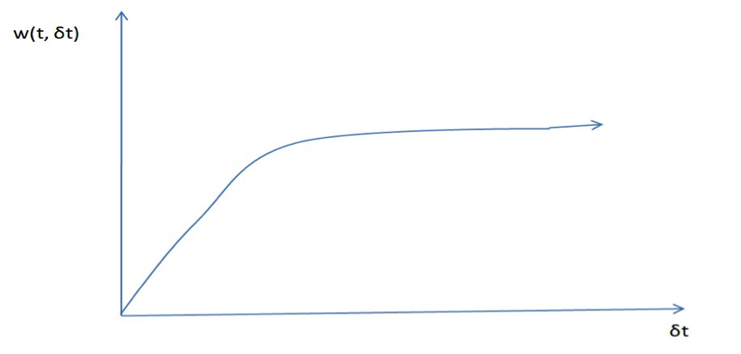
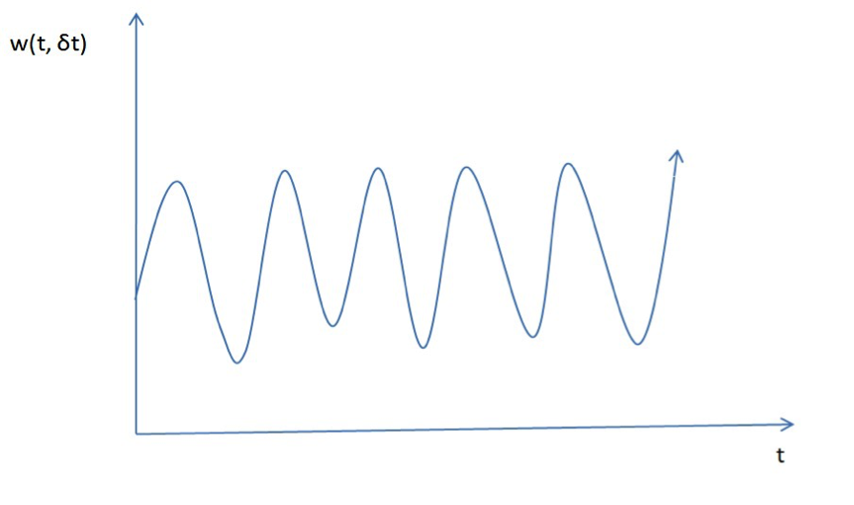
Memory Utilization Increase Challenges
Memory utilization could be wrong, need to use memory working set
Rethinking memory working set
Formula | Comments
(Total - Free) / Total | Not good. There are lots of file read/write once cases.
(Total - Free – Inactive Cache) / Total | Not good. Cache could be still actively used.
(Memory Working Set) / Total | Sounds good. But how do you get the Working Set?
Co-location: Memory reclaim always works.
Paper: The Working Set Model for Program Behavior - ACM 1968
Working Sets Past and Present – IEEE 1980
More Than Just Cloud

Slide 32
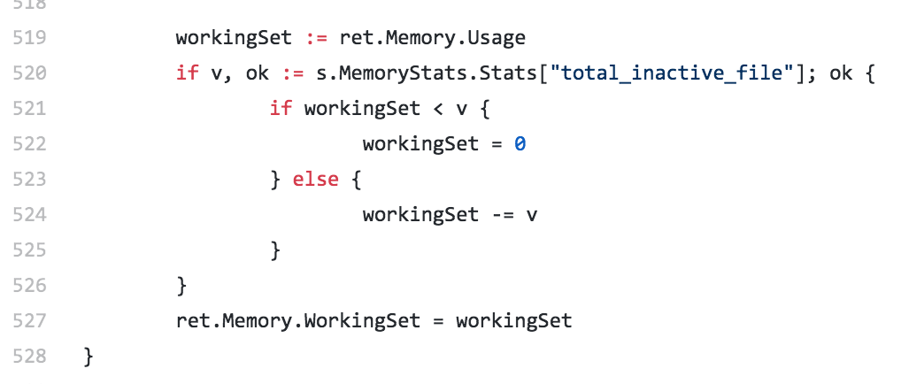
Memory Working Set Estimation
Use LRU inactive size
Kubernetes: WS = Usage – Inactive Page Cache
Use Linux idle page tracking
Kubernetes RFE: https://github.com/kubernetes/kubernetes/issues/12422
Source code：https://github.com/google/cadvisor/blob/master/container/libcontainer/handler.go#L519
More Than Just Cloud

Slide 33
Linux Idle Page Tracking
Use Case
Documentation/admin-guide/mm/idle_page_tracking.rst
Estimate workload's working set size, so that…
Setting memory cgroup upper limits for resource control
Setting memory cgroup low limits for best efforts working set protection.
Deciding where to place the workload within a compute cluster.
Determine the effective memory utilization
Interfaces
New: /sys/kernel/mm/page_idle/bitmap
Cooperate existing kernel information
Per-process: /proc/PID/pagemap
Per-cgroup: /proc/kpagecgroup
System wide: (0..MAX_PFN]
Identify special pages: /proc/kpageflags
More Than Just Cloud

Slide 34
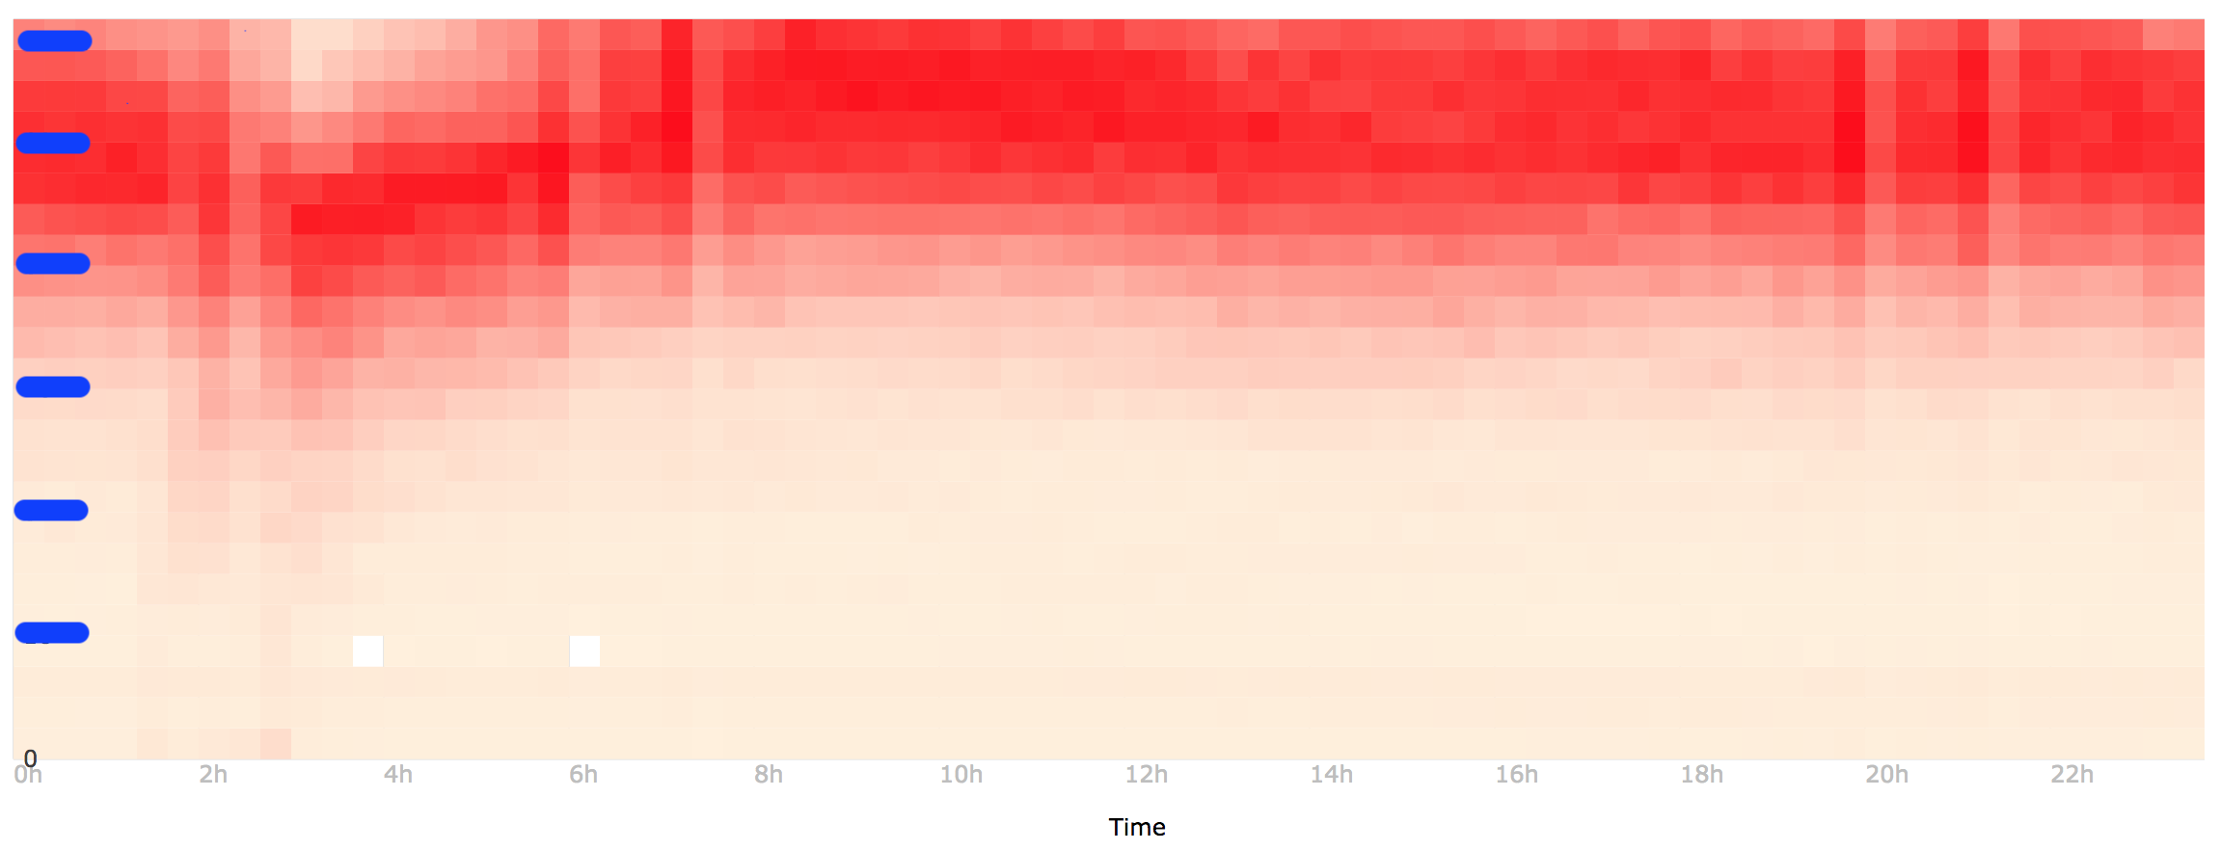
Redefine Memory Utilization
Effective Memory Utilization
No Swap: (Total - Free - Idle Page Cache) / Total
With swap: (Total - Free - Idle Memory) / Total
Online capacity planning by effective memory utilization
Online/offline data analysis from any clusters (thousand of machines)
Understand spatial and time imbalance of memory resource
More Than Just Cloud

Slide 35
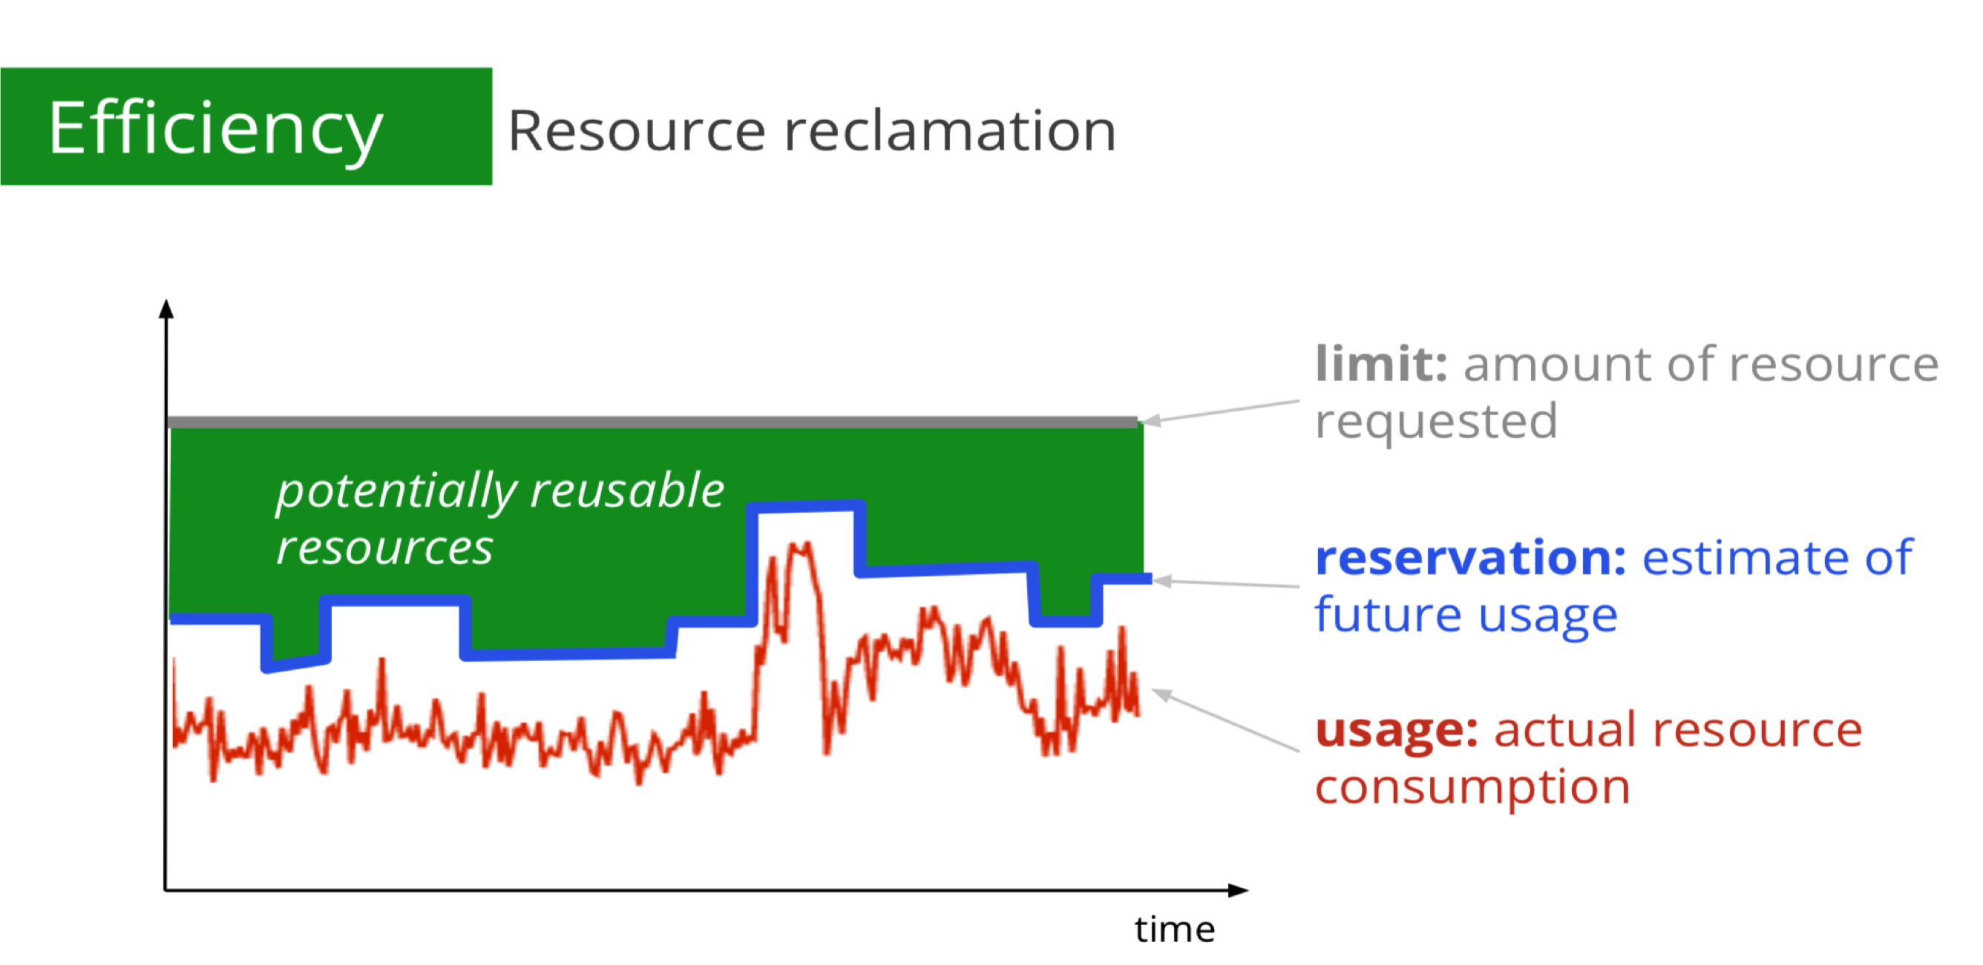
Memory Reclamation & Challenges
Key idea:
Find reusable memory for Best-Effort workload
Kill Best Efforts workload proactively while memory contentions
Challenges: Memory utilization & QoS tradeoffs
Accurate working-set estimation for continuously-varying load
To quickly find reusable memory resource
To predict & detect memory starving accurately
Idle page tracking gives accurate working-set estimation
Paper: Large-scale cluster management at Google with Borg - EuroSys 2015
More Than Just Cloud

Slide 36
5. Summary
More Than Just Cloud

Slide 37
Recap
Memory performance isolation
Using PMU counters for hardware resource contention detection
Low free memory causes lots of OS Jitters, need a smarter way
Using online cluster statistics for utilization and QoS tradeoff
Memory faults isolation
Using RunV solution to meet higher QoS requirements
For RunC, try to avoid/predict faults, such as OOM, split-lock, to overcome jitters
Memory utilization increase
Capacity planning can be more accurate by using idle page tracking
Continuously varying load requires online capacity planning
Memory reclamation solution relies on accurate working-set estimation
More Than Just Cloud

Slide 38
References
Linux Idle Page Tracking
Intel Top-down Microarchitecture Analysis Method
Brendan Gregg Blogs
CPU utilization is wrong
CPI flame graph
How To Measure the Working Set Size on Linux
Resctrl UI
Perf C2C
More Than Just Cloud

Slide 39


Alibaba Cloud
MISSION
为了无法计算的价值
More Than Just Cloud
VISION
成为全球云数据大计算的领导者
Pioneer of Cloud Data and Big Computing
A TEAM OF EXPERTS
6000+ Top Technology Experts Based in Hangzhou, Beijing, Silicon Valley and Seattle.
More Than Just Cloud

Slide 40



